Slide 1

DEPARTMENT OF COMPUTER SCIENCE & ENGINEERING “MPEG-4”
COURSE NAME : MINI PROJECT
COURSE CODE:20CSE59
Presentation by,
NAME B.LAKSHMI KEERTHI
USN 1NH18CS038
Under the Guidance of ,
Guide Name Ms. Shanmuga Priya
Designation Associate Professor

Slide 2

MPEG-4
THE EYES OF OFFLINE

Slide 3
Course objectives
The main objective of this project is to download the video from YouTube by its unique URL link.
The user can save the downloaded video in his/her wished path in the PC.
Downloaded stuff can be easily found.
One of the best advantages of this downloaded videos is it doesn't depends on the network.

Slide 4
PROBLEM STATEMENT:
Now a days people are facing problems and having some troubleshooting issues while watching for many reasons like network, low battery , human disturbance , personal issues etc for such things this project MPEG-4 will help us to download the videos, by the specific link of the particular video which is been selected . So the user can easily download and also can share it to another person so that they can watch the downloaded videos at any place with irrespective to their network (offline) . MPEG-4 files with audio and video generally use the standard .mp4 extension.

Slide 5
Outcomes:
If the user pastes the URL link and press the OK button then the video/playlist/file is been downloaded and will be saved in our respective pc.
If the user want to see all the videos which are downloaded previously then user can go to there stored downloaded list and can take a look in it.

Slide 6
Hardware and software components used:
hardware requirement
Core i5
8th generation
Ram: 2 GB or more
software requirement
Python having 3.8.5 version(idle , tkinter),PyCharm,PyQt5.
OS: Windows 7 or later

Slide 7
Er diagram:
GUI(having a text field to paste URL
Download
File
Playlist
Video
URL
URL
URL

Slide 8
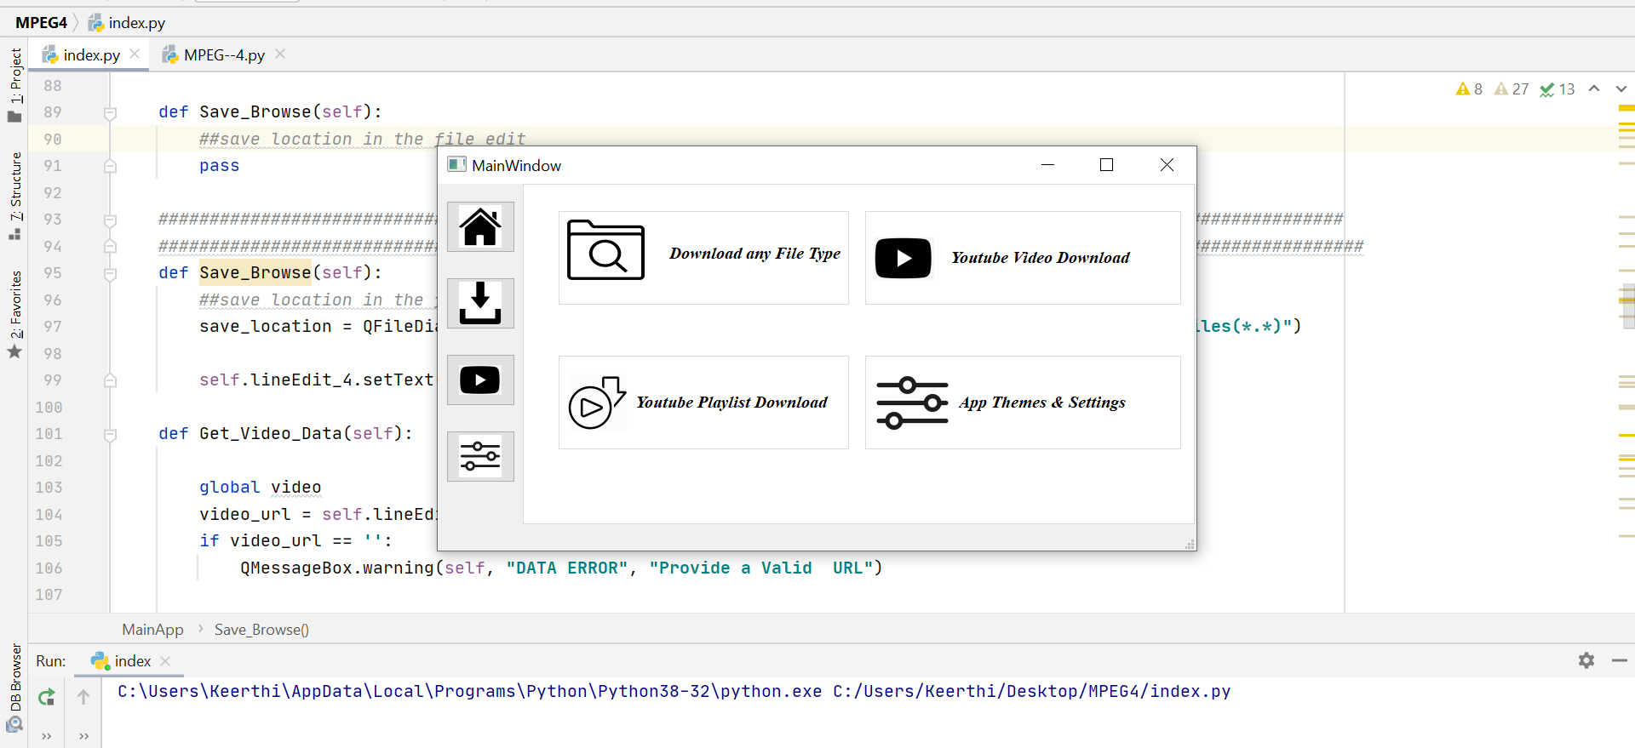
FEW outputs:
Displays the Home Page.

Slide 9
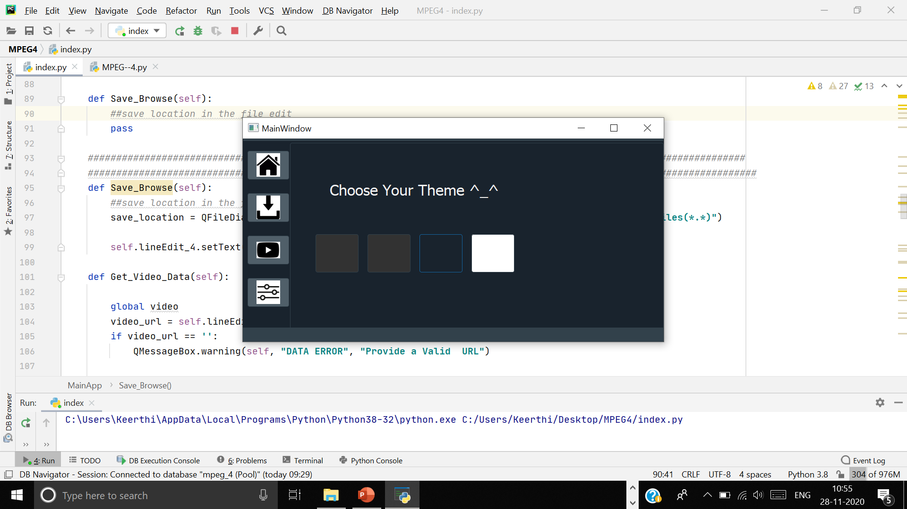
The Theme Changing option …

Slide 10
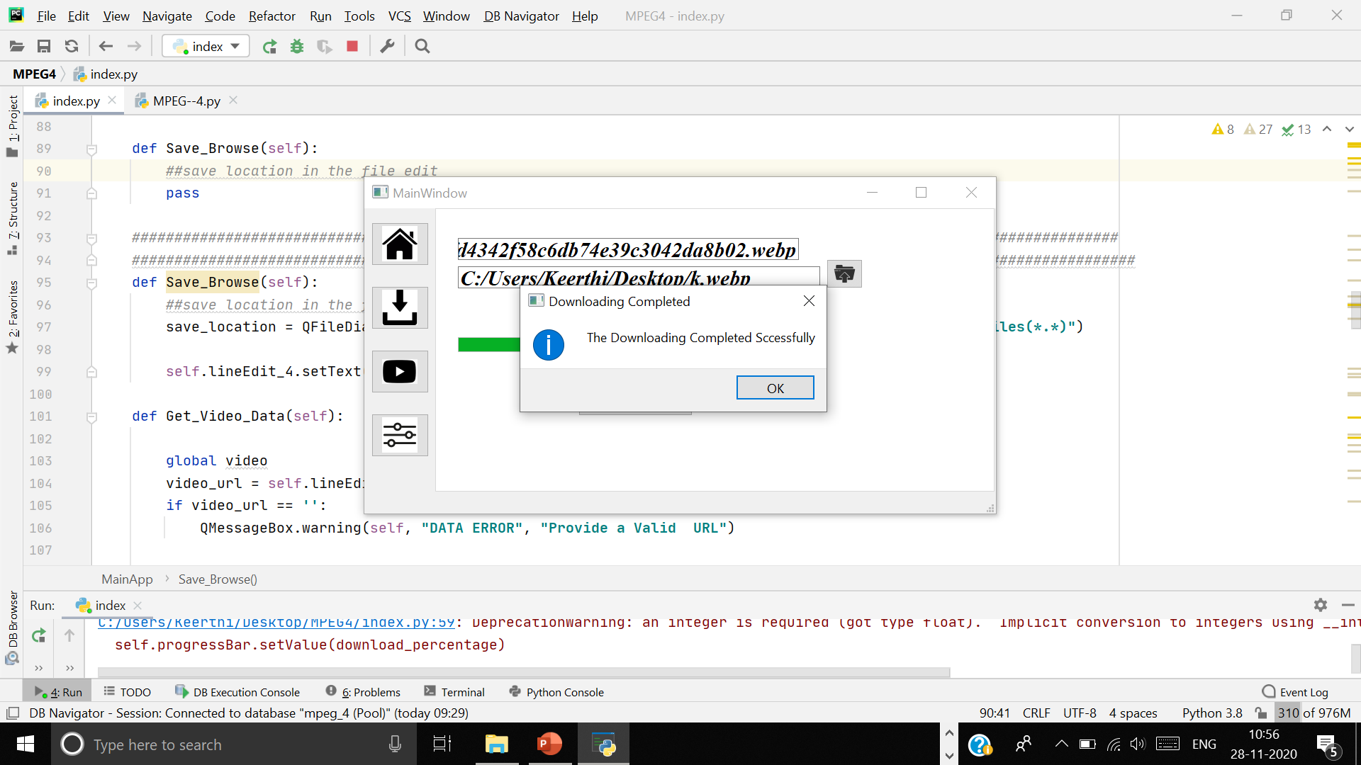
File Downloading .

Slide 11
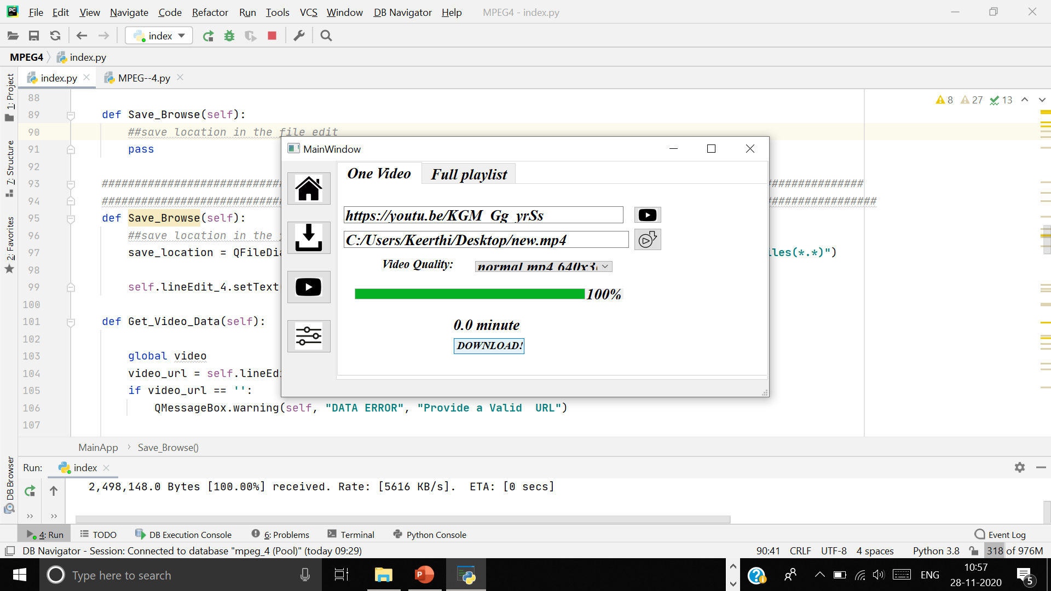
Video Downloading.

Slide 12

Thank you

